Slide 1
FPGA BASED DEFRIBILLATORS SIGNAL DECTECTION USING ECG SIGNALS
By Group-3

Slide 2
INTRODUCTION
Defibrillators require fast and accurate detection of abnormal heart rhythms, such as ventricular fibrillation (VF) and ventricular tachycardia (VT), to deliver timely life-saving shocks.
ECG (Electrocardiogram) signals provide real-time information about electrical activity of the heart, helping identify dangerous arrhythmias that need defibrillation.
Traditional microcontroller-based systems may face latency and processing limitations, especially when handling continuous high-speed biomedical signals.
FPGA (Field Programmable Gate Array) technology offers high-speed parallel processing, making it ideal for real-time ECG signal acquisition, filtering, and arrhythmia detection.
The project implements signal conditioning, noise removal, and rhythm classification on FPGA, ensuring reliable detection of defibrillation-triggering events.
By integrating ECG analysis on FPGA, the defibrillator system becomes faster, more accurate, and more reliable, improving patient survival chances during cardiac emergencies.

Slide 3
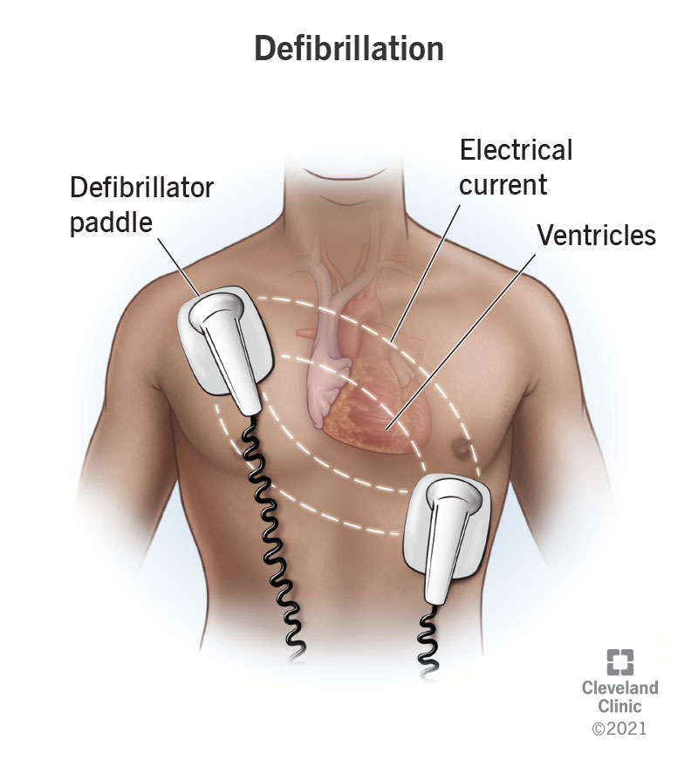
DEFRIBILLATORS?
Defibrillators are medical devices that give an electric shock to the heart when it stops beating properly.
They are used to restart the heart or bring it back to a normal rhythm during emergencies.
They are mainly used when a person has life-threatening arrhythmias, like ventricular fibrillation (VF) or ventricular tachycardia (VT).
The electric shock helps to reset the heart’s electrical activity, allowing it to beat normally again.
Defibrillators are used by doctors, paramedics, and even the public (AEDs found in malls, airports, offices).
They are important because they can save a person’s life within minutes if used quickly during cardiac arrest.

Slide 4
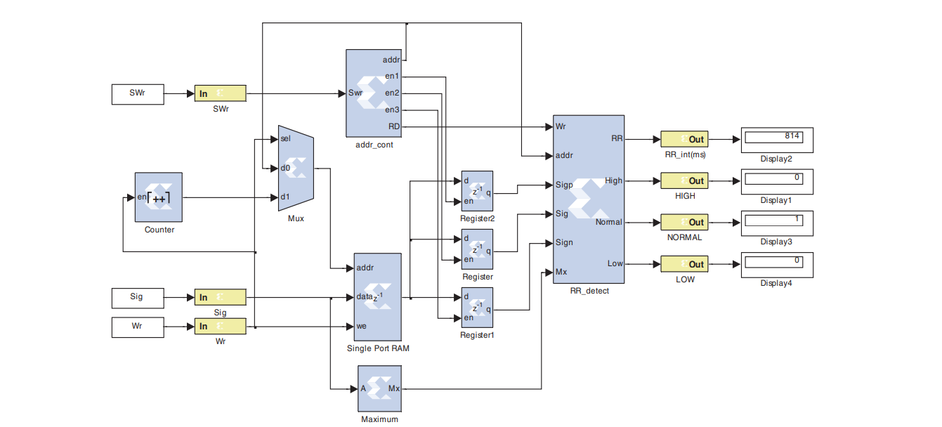
BLOCK DIAGRAM
ECG signal comes in and is given to the FPGA along with a write control signal (Wr).
A counter creates addresses so that each ECG value can be stored in memory (RAM).
The RAM stores the ECG samples, one by one, at the addresses created by the counter.
Registers take the stored ECG samples to check the previous, current, and next values.
The RR_detect block finds the R-peak and calculates the time gap between two R-peaks (RR interval).
Finally, the FPGA shows the result — whether heart rate is HIGH, NORMAL, or LOW — on the display.

Slide 5
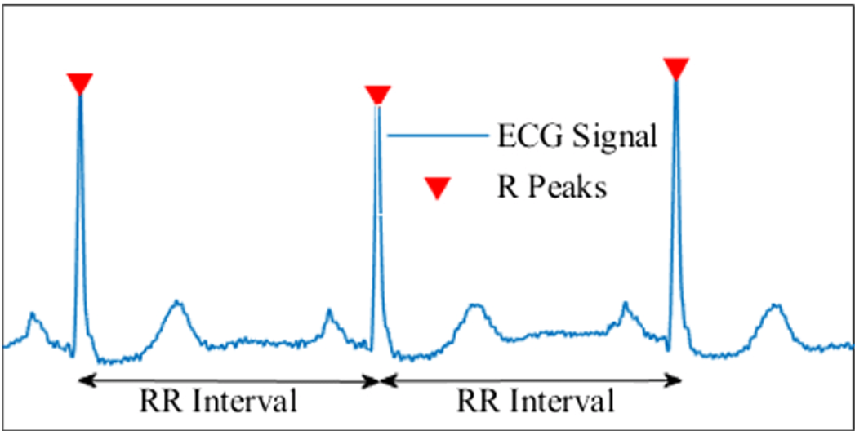
R-R PEAK INTERVAL CALCULATION
Detects the R-peak in the ECG signal by checking where the signal reaches a maximum point.
Measures the time gap between two R-peaks, called the RR interval.
Calculates heart rate using the RR interval.
Compares the heart rate with limits to decide if it is HIGH, NORMAL, or LOW.
Sends the outputs (RR interval, HIGH, NORMAL, LOW) to the display.

Slide 6
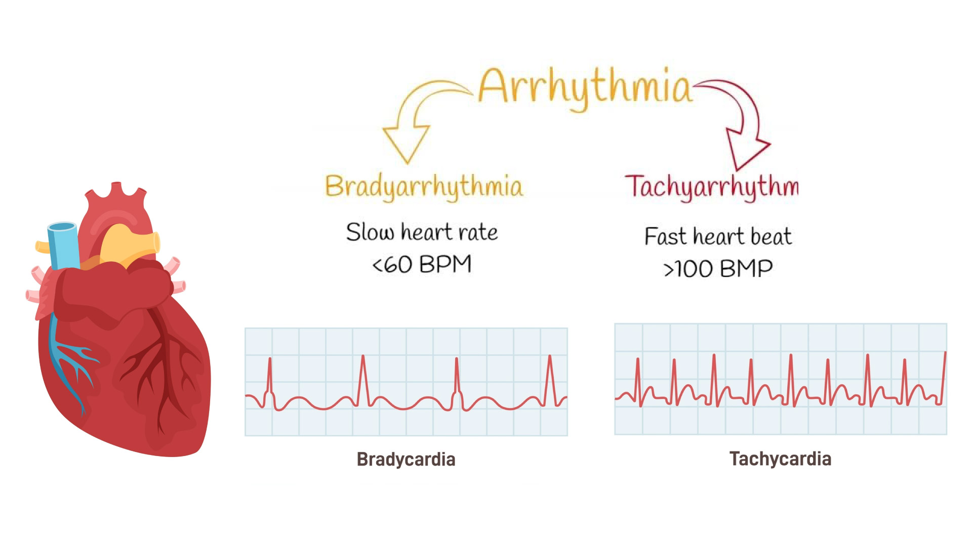
IRREGULAR HEART RHYTHM?
Arrhythmia means an irregular heartbeat — the heart does not beat in a normal, steady rhythm.
The heartbeat may become:
Too fast (Tachycardia)
Too slow (Bradycardia)
Uneven or skipping beats
Arrhythmia occurs when the electrical signals in the heart do not work properly.
Some arrhythmias are harmless, but others can be dangerous and life-threatening.
Dangerous arrhythmias like Ventricular Fibrillation (VF) and Ventricular Tachycardia (VT) can stop blood flow and require immediate treatment.

Slide 7
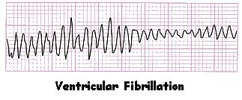
Ventricular Fibrillation (VF)
VT is a very fast heart rhythm that starts in the ventricles (lower chambers).
The heart beats too fast to fill with blood properly, so blood flow drops.
VT can cause dizziness, chest pain, or fainting.
If not treated, VT can quickly turn into Ventricular Fibrillation (VF).
VT is often treated using a defibrillator shock to bring rhythm back to normal.

Slide 8
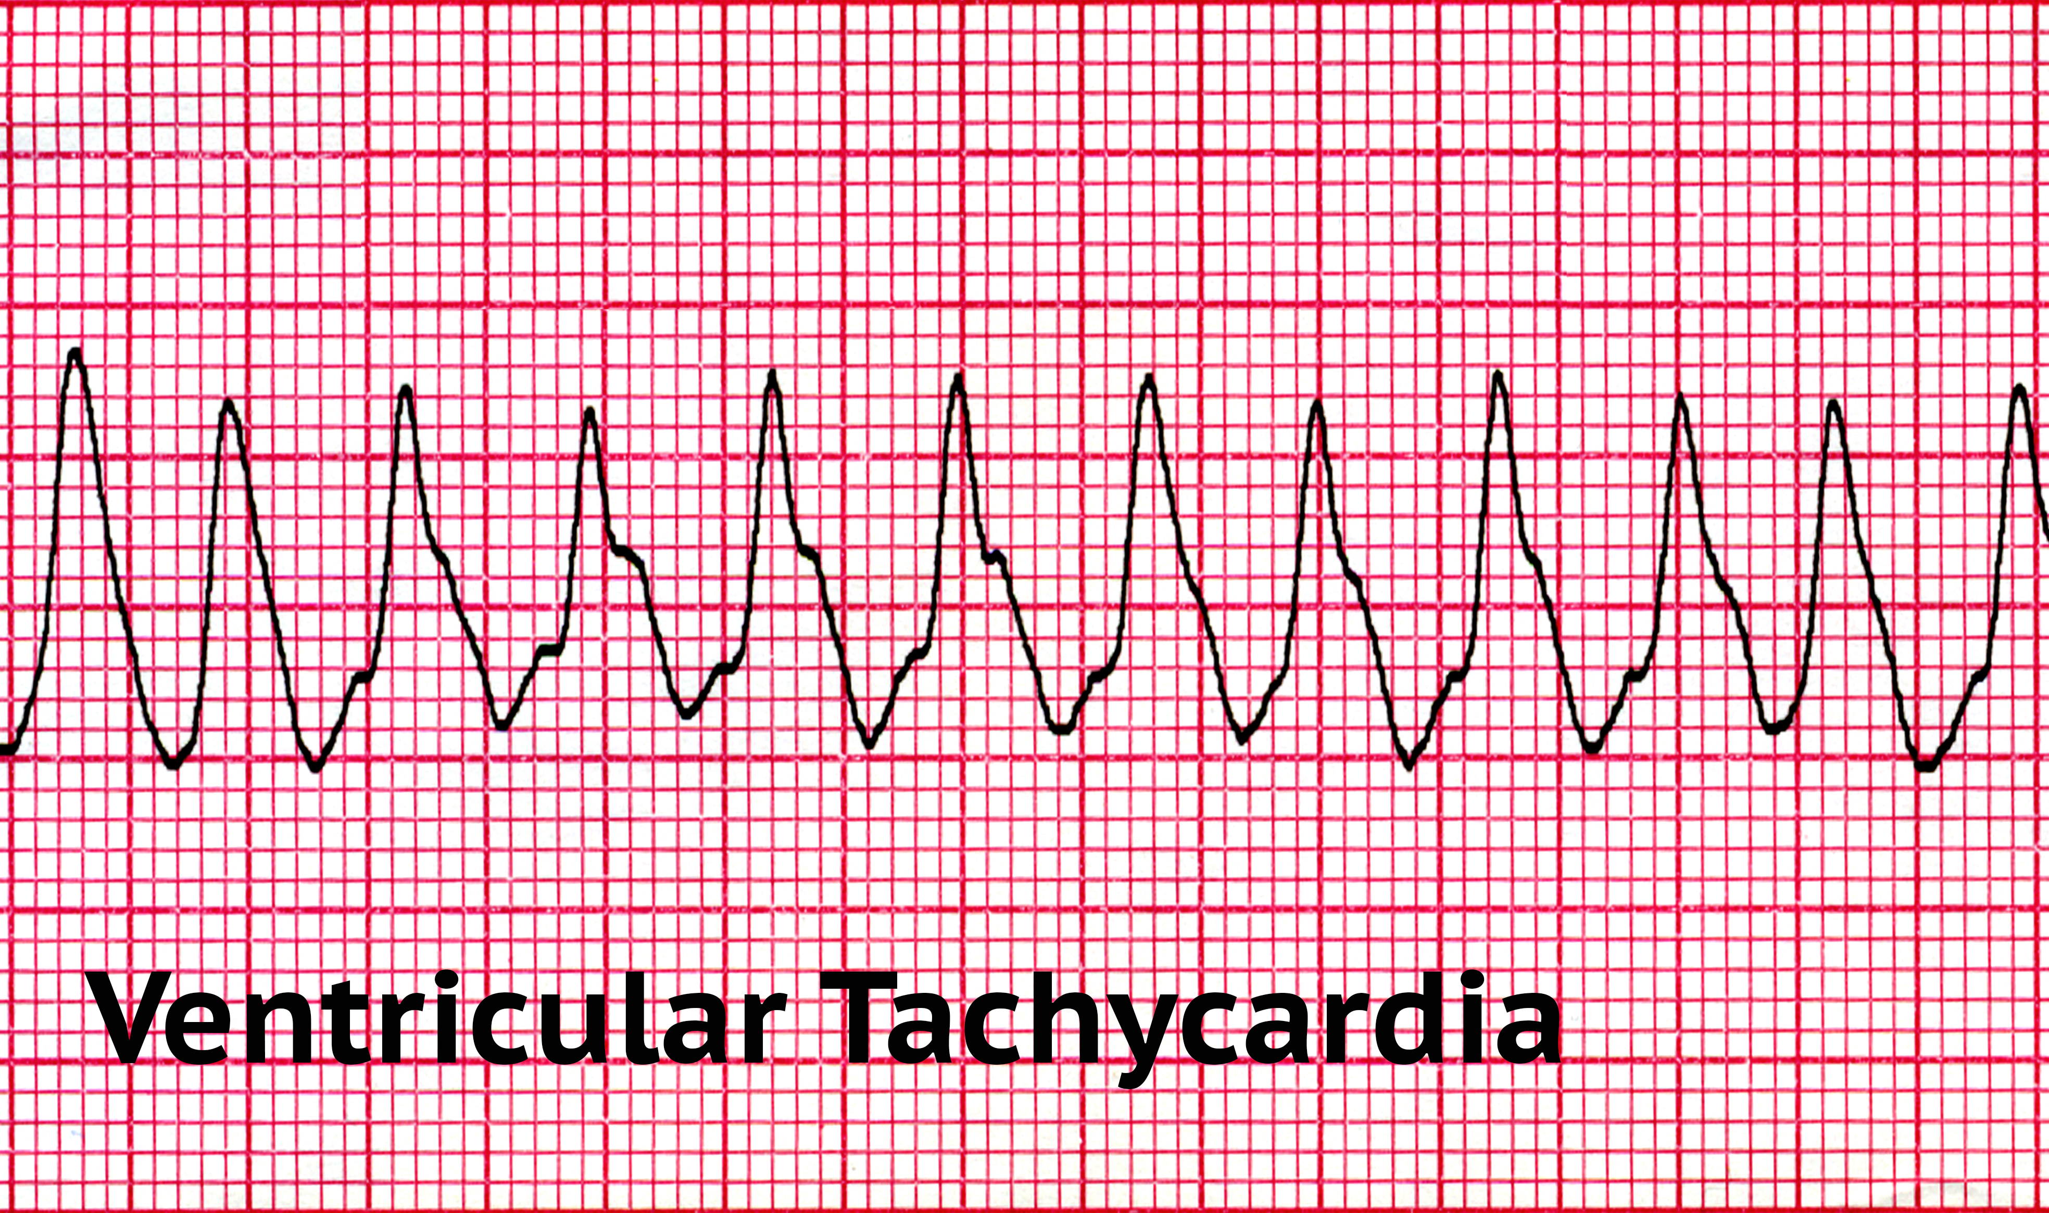
Ventricular Tachycardia (VT)
VF is the most dangerous heart rhythm, where the ventricles quiver instead of pumping blood.
The electrical signals in the heart become chaotic and uncoordinated.
Because the ventricles don’t pump, blood flow stops immediately.
The person collapses, becomes unconscious, and death can occur within minutes.
Only an immediate defibrillator shock can stop VF and restore a normal rhythm.

Slide 9
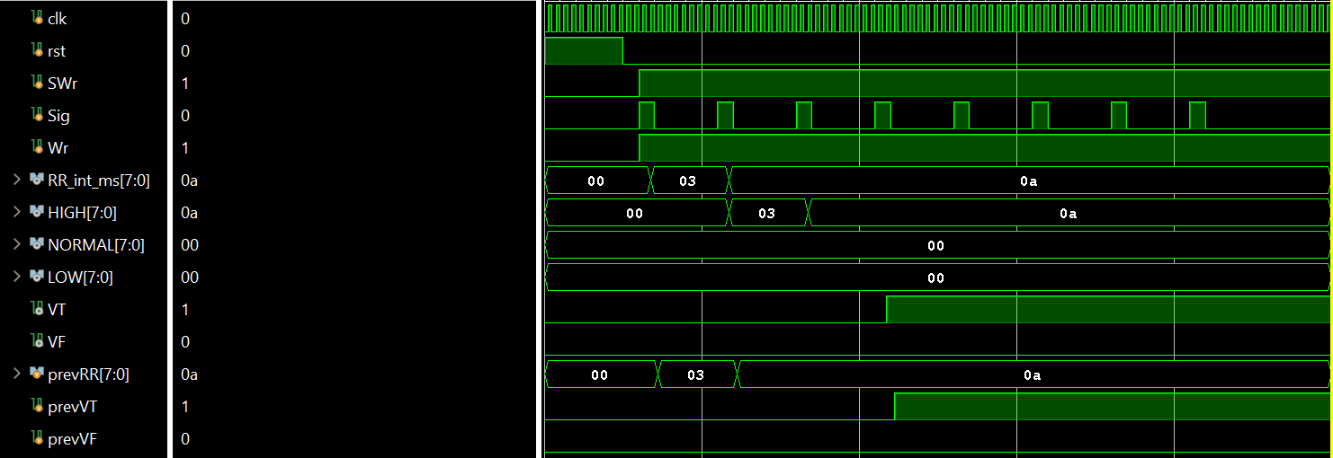
Output:
R-peaks (Sig pulses) are detected The small pulses on Sig represent detected R-peaks in the ECG signal, and each one triggers calculation of an RR interval.
RR interval output updates RR_int_ms shows values like 03, 0A, etc. These values represent the measured time between successive R-peaks.
Heart-rate classification logic works
HIGH, NORMAL, LOW update depending on the RR interval length.
VT (Ventricular Tachycardia) detection activates The VT signal goes HIGH (1) because multiple consecutive RR intervals are very short (like 03), indicating fast and regular rhythm → characteristic of VT.
VF remains LOW VF = 0 because the intervals are fast but not irregular. VF requires chaotic, highly variable RR intervals, which are not present in this waveform.

Slide 10
APPLICATIONS:
Real-Time Cardiac Monitoring
Detects abnormal heart rhythms (like VF or VT) instantly using live ECG signals.
Automated External Defibrillators (AEDs)
FPGA enables fast and reliable detection for automatic shock delivery in emergency situations.
Hospital Intensive Care Units (ICUs)
Provides continuous ECG analysis for critical patients to alert medical staff immediately.
Wearable or Portable Health Devices
Enables compact, low-power ECG monitoring for patients at home or during travel.
Ambulance and Emergency Medical Systems
Supports rapid arrhythmia detection and defibrillation while transporting patients.

Slide 11
Future Improvements:
Integration with IoT and Cloud
Enables remote monitoring and real-time alerts for doctors or emergency services.
Portable and Wearable Devices
Miniaturized FPGA-based systems for continuous at-home ECG monitoring.
AI/ML-Based Arrhythmia Detection
Improves accuracy by detecting complex or rare heart abnormalities.
Low-Power and Battery Optimization
Extends operational time for portable or implantable defibrillator systems.
Multi-Lead ECG and Advanced Signal Processing
Supports multiple leads and better noise filtering for more precise detection.

Slide 12
THANK YOU

